Slide 1


HEART DISEASE PREDICTION
Summer Internship
On Machine Learning using Python
Jointly Offered by
NIELIT Guwahati and AI club, Cit Kokrajhar
PRESENTED BY:
Tandeep Das (202102022083) CSE
Dhanjit Boro (202102022084) CSE
Derhasath Borgayary (202102022088) CSE
Mithisath Narzary (202102022109) CSE
Heart Disease Prediction
20th July, 2023

Slide 2
CONTENTS:
Summer Internship
On Machine Learning using Python
Jointly Offered by
NIELIT Guwahati and AI club, Cit Kokrajhar
Problem Statement
Literature Survey / Related Works
Objectives
System Requirements
Data Flow Chart
Heart Dataset
Proposed Methodology
Results
References
Heart Disease Prediction
20 July, 2023

Slide 3
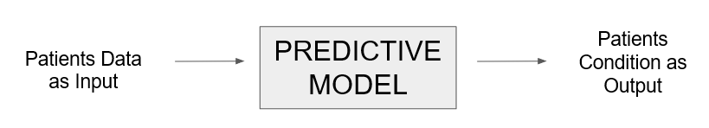
Problem Statement:
Summer Internship
On Machine Learning using Python
Jointly Offered by
NIELIT Guwahati and AI club, Cit Kokrajhar
Predict whether a patient is diagnosed with Heart Disease using his/her present and past medical and behavioral data.
This is a binary outcome.
Positive (+) = 1, patient has heart disease.
Negative (-) = 0, patient do not have heart disease.
Heart Disease Prediction
20 July, 2023

Slide 4
Literature Survey / Related Works:
Summer Internship
On Machine Learning using Python
Jointly Offered by
NIELIT Guwahati and AI club, Cit Kokrajhar
Drod et al. (2022): The objective was to use machine learning (ML) techniques to identify the most significant risk variables for cardiovascular disease (CVD) in patients with metabolic-associated fatty liver disease (MAFLD).
According to the study, hypercholesterolemia, plaque scores, and duration of
diabetes were the most crucial clinical characteristics.
Algorithms used: logistic regression classifier, univariate feature ranking, and
principal component analysis (PCA).
Alotalibi (2019): The author aimed to investigate the utility of machine learning (ML) techniques for predicting heart failure disease. This study provides insight into the potential of ML techniques as an effective tool for predicting heart failure disease and highlights the decision tree algorithm as a potential option for future research.
Algorithms used: decision tree, logistic regression, random forest, naive Bayes,
and support vector machine (SVM).
Heart Disease Prediction
20 July, 2023

Slide 5
Objectives
Summer Internship
On Machine Learning using Python
Jointly Offered by
NIELIT Guwahati and AI club, Cit Kokrajhar
Develop a predictive model.
Improve early detection.
Enhance accuracy and precision.
Reduce healthcare burden.
Evaluate and compare models.
Validate the model's effectiveness.
Saving and loading the model.
Deploying the model using Flask as an web application.
Heart Disease Prediction
20 July, 2023

Slide 6

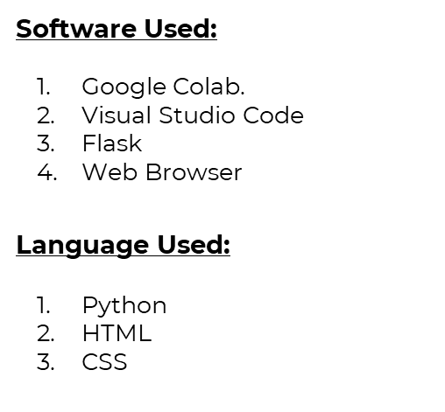
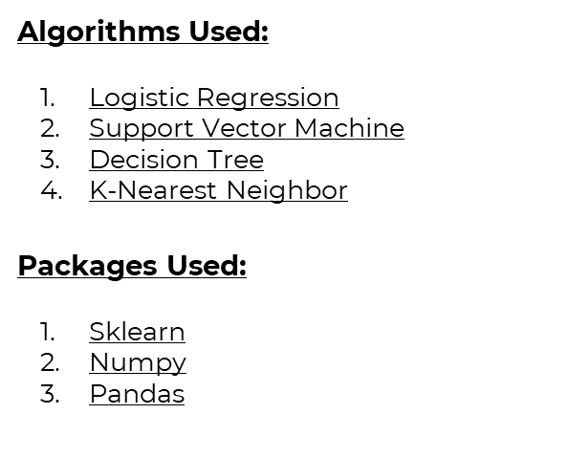
Summer Internship
On Machine Learning using Python
Jointly Offered by
NIELIT Guwahati and AI club, Cit Kokrajhar
Heart Disease Prediction
20 July, 2023

Slide 7

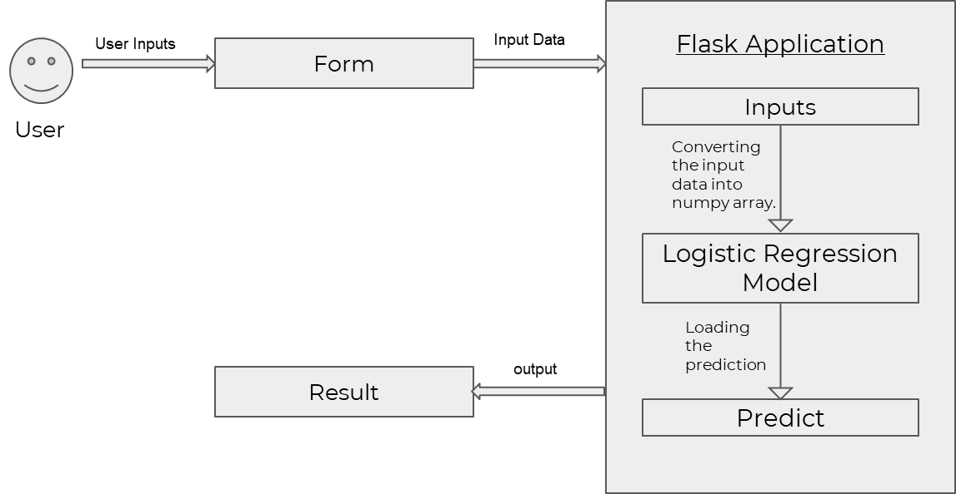
Summer Internship
On Machine Learning using Python
Jointly Offered by
NIELIT Guwahati and AI club, Cit Kokrajhar
Heart Disease Prediction
20 July, 2023

Slide 8
Summer Internship
On Machine Learning using Python
Jointly Offered by
NIELIT Guwahati and AI club, Cit Kokrajhar
Heart Dataset:
Demographic Attributes in the dataset are:
Age and Gender
Medical History Attributes in the dataset are:
cp(Chest Pain Type), trestbps(Resting Blood Pressure), chol(cholesterol level), oldpeak(ST depression induced by exercise relative to rest ), thalach(Maximum heart rate achieved during exercise) and exang(Exercise-induced angina)
Current Medical Condition Attributes in the dataset are:
restecg(Resting electrocardiographic results), ca(Number of major vessels colored by fluoroscopy), thal(Thalassemia, a blood disorder) and slope(Slope of the peak exercise ST segment)
Heart Disease Prediction
20 July, 2023

Slide 9
Summer Internship
On Machine Learning using Python
Jointly Offered by
NIELIT Guwahati and AI club, Cit Kokrajhar
Proposed Methodology:
Data Collection: The Data that is collected, are the users medical data.
Data Prepossessing: The collected data is than preprocessed to remove any noise and prepare the data be trained.
Model Training and Testing: The preprocessed that is than trained and tested using the Machine Learning model(in our case the logistic Regression model is used for the training and testing.)
Model Evaluation: The trained and tested model is than evaluated using various evaluation techniques such as pression, accuracy, F1-Score and Recall Score to see how well it will perform and predict the users data.
Model Saving and Loading: The trained model and the standard scaler is saved and loaded using Pickle.
Deployment:The trained, tested and evaluated data is than deployed so that it can be used by other industries and medical institutes.
Heart Disease Prediction
20 July, 2023

Slide 10
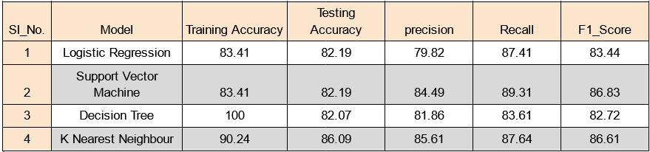
Results Comparison:
Summer Internship
On Machine Learning using Python
Jointly Offered by
NIELIT Guwahati and AI club, Cit Kokrajhar
Heart Disease Prediction
20 July, 2023

Slide 11
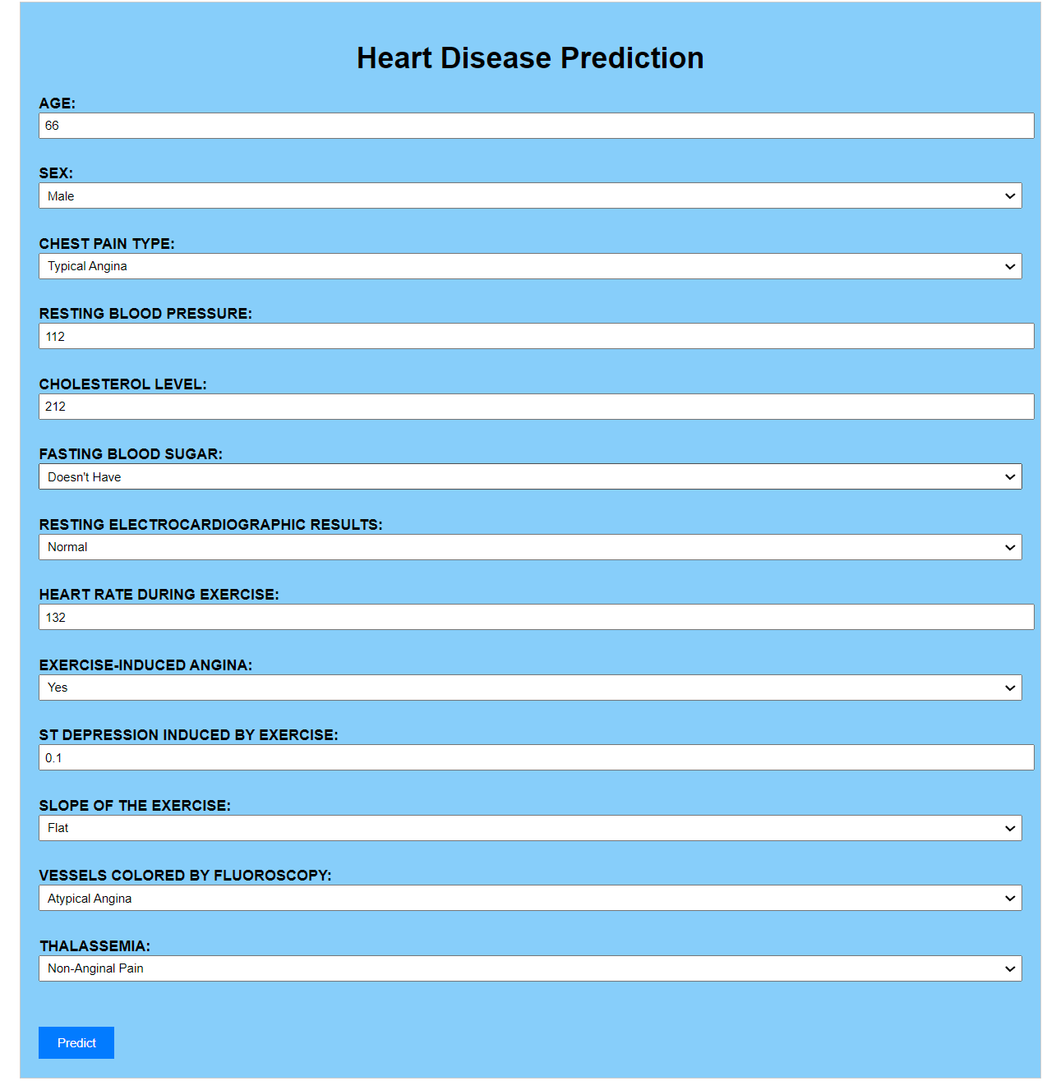

Deployment Results:
Summer Internship
On Machine Learning using Python
Jointly Offered by
NIELIT Guwahati and AI club, Cit Kokrajhar
Heart Disease Prediction
20 July, 2023

Slide 12
References
Summer Internship
On Machine Learning using Python
Jointly Offered by
NIELIT Guwahati and AI club, Cit Kokrajhar
[1]Heart DataSet training and testingdata:
https://www.kaggle.com/code/jaiminmukeshjariwala/ml-prac-2-logistic-regression-from-scratch/notebook
[2]Literature and Survey:
https://www.mdpi.com/1999-4893/16/2/88#:~:text=Previous%20studies%20have%20reported%20accuracy,be%20generalizable%20to%20larger%20populations.
[3]The Hundred Page Machine Learning Book.pdf:
https://pdfcoffee.com/the-hundred-page-machine-learning-bookpdf-pdf-free.html
[4] Heart Dataset:
www.kaggle.com
[5] Programming:
https://stackoverflow.com
Heart Disease Prediction
20 July, 2023

Slide 13
Summer Internship
On Machine Learning using Python
Jointly Offered by
NIELIT Guwahati and AI club, Cit Kokrajhar
THANK YOU
Heart Disease Prediction
20 July, 2023

